Slide 1
Week 2:
On
Cloud Services and Deployment Models
Dr. ManjuLata Rathi

Slide 2
The Third Generation
reach
The Cloud
The Web
virtualized services
information & e-commerce
The Internet
connectivity
1970
1980
1990
2000
2005
2010
2020
“A pool of abstracted, highly scalable, and managed infrastructure capable of hosting end-customer applications and billed by consumption,” Forrester

Slide 3















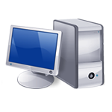
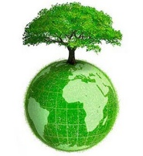





I need to grow my infrastructure, but I do not know for how long…
I have a lot of infrastructure that I want to rent …
I have a surplus of infrastructure that I want to make use of
I cannot invest in infrastructure, I just started my business….
I have infrastructure and middleware and I can host applications
I want to focus on application logic and not maintenance and scalability issues
Global Cloud Marketplace
I have infrastructure and provide application services
I want to access and edit my documents and photos from everywhere..

Slide 4
INTRODUCTION
Cloud Computing provides us a means by which we can access the applications as utilities, over the Internet. It allows us to create, configure, and customize applications online.
With Cloud Computing users can access database resources via the internet from anywhere for as long as they need without worrying about any maintenance or management of actual resources.

Slide 5
What is Cloud?
The term Cloud refers to a Network or Internet. In other words, we can say that Cloud is something, which is present at remote location.
Cloud can provide services over network, i.e., on public networks or on private networks, i.e., WAN, LAN or VPN (Virtual Private Network).
Applications such as e-mail, web conferencing, customer relationship management (CRM), all run in cloud.

Slide 6
No capital investments
Cloudbusrting
SaaS
Quality of Service
Pay as you go
Internet
PaaS
Green computing
IaaS
Billing
Utility computing
Elasticity
IT outsourcing
Service Level Agreement
Virtual Datacenters
Scalability
IT outsourcing
Privacy & Trust
Provisioning
on demand
Security
Cloud Computing?
Virtualization

Slide 7
What is Cloud Computing?
Cloud Computing refers to manipulating, configuring, and accessing the applications online.
It offers online data storage, infrastructure and application.
Cloud Computing is both a combination of software and hardware based computing resources delivered as a network service.

Slide 8
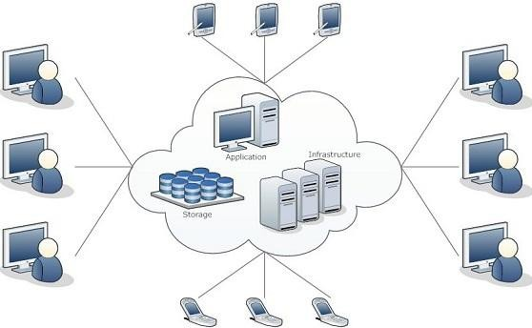
Cloud Computing Architecture

Slide 9
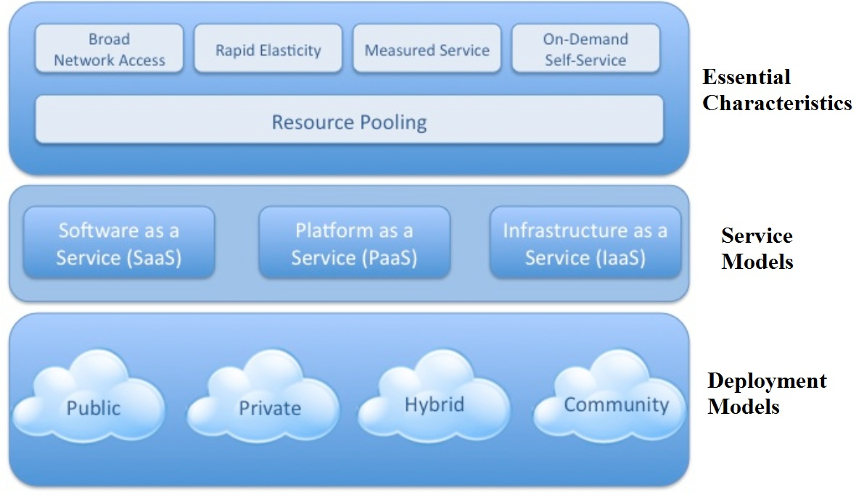
NIST: Cloud Computing Architecture

Slide 10
Basic Concepts
There are certain services and models working behind the scene making the cloud computing feasible and accessible to end users. Following are the working models for cloud computing:
Deployment Models
Service Models

Slide 11
Deployment Models
Deployment models define the type of access to the cloud, i.e., how the cloud is located? Cloud can have any of the four types of access: Public, Private, Hybrid and Community.

Slide 12
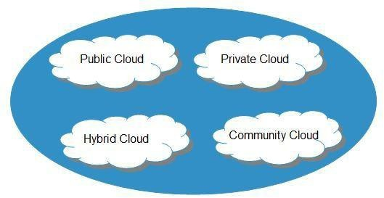

Slide 13
PUBLIC CLOUD : The Public Cloud allows systems and services to be easily accessible to the general public. Public cloud may be less secure because of its openness, e.g., e-mail.
PRIVATE CLOUD : The Private Cloud allows systems and services to be accessible within an organization. It offers increased security because of its private nature.
COMMUNITY CLOUD : The Community Cloud allows systems and services to be accessible by group of organizations (e.g., mission, security requirements, policy, or compliance considerations).
HYBRID CLOUD : The Hybrid Cloud is mixture of public and private cloud. However, the critical activities are performed using private cloud while the non-critical activities are performed using public cloud.

Slide 14
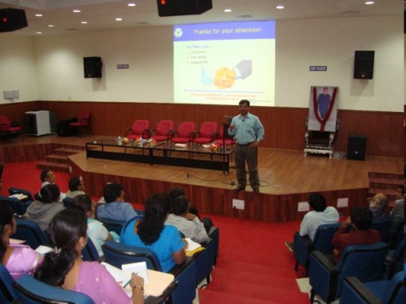

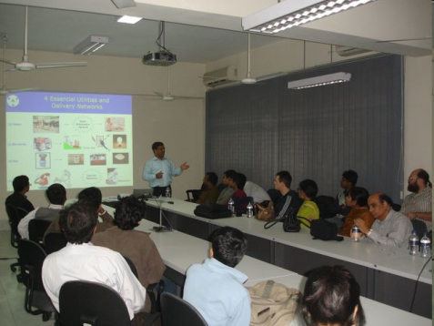
Public/Internet Clouds
Private/Enterprise Clouds
Hybrid/Mixed Clouds
3rd party, multi-tenant Cloud
infrastructure & services:
* available on subscription basis (pay as you go)
Cloud computing model run within a company’s own Data Center / infrastructure for internal and/or partners use.
Mixed usage of private and public Clouds:
Leasing public cloud services when private cloud capacity is insufficient

Slide 15
Service Models
Service Models are the reference models on which the Cloud Computing is based. These can be categorized into three basic service models.

Slide 16
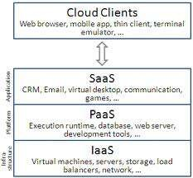
What are Cloud Stacks?
Cloud Services can be dived into
3 stacks:
Infrastructure as a Service: IaaS
Platform as a Service: PaaS
Software as a Service: SaaS

Slide 17

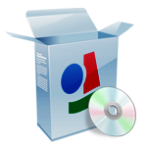
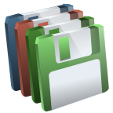


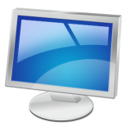
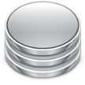
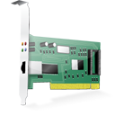
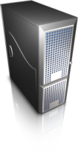



Guest
Virtual Image
Applications
Applications
Virtualization Layer
Virtual Hardware
Virtual Storage
Virtual Networking
Software Emulation
Host
Physical Hardware
Physical Storage
Physical Networking

Slide 18
Applications
Application - level Virtualization
Programming Languages
Programming Language level Virtualization
Execution Stack
Operative Systems
OS- level Virtualization
Hardware
Hardware - level Virtualization

Slide 19
Infrastructure as a Service (IaaS)
This is the base layer of the cloud stack.
It serves as a foundation for the other two layers, for their execution. The
keyword behind this stack is Virtualization.
Let us try to understand this using Amazon EC2. In Amazon EC2 (Elastic Compute Cloud) your application will be executed on a virtual computer (instance).
The whole cloud infrastructure viz. servers, routers, hardware based load-balancing, firewalls, storage & other network equipments are provided by the IaaS provider. The customer buy these resources as a service on a need basis.

Slide 20
Platform as a Service (PaaS)
Now you don’t need to invest millions of $$$ to get that development foundation ready for your developers. The PaaS provider will deliver the platform on the web, and in most of the cases you can consume the platform using your browser, i.e. no need to download any software.
PaaS Layers
Cloud OS
Cloud Middleware
PaaS Examples
Google App Engine and Windows Azure are examples of Cloud OS. OrangesScape & Wolf PaaS are cloud middleware.

Slide 21

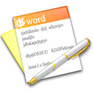


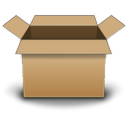

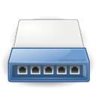
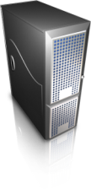
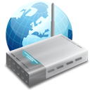
Frameworks for distributed programming
Applications
Middleware
IPC primitives for control and data.
Operating System
Networking and Parallel Hardware
Hardware

Slide 22

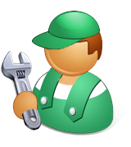
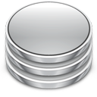
Social Networks, Scientific Computing, Enterprise Applications
Applications (SaaS)
Frameworks for
Cloud Application Development
Middleware (PaaS)
Virtual hardware, networking, OS images, and storage.
Hardware and OS (IaaS)

Slide 23
Software as a Service (SaaS)
This is the Top most layer of the cloud computing stack - directly consumed by end user – i.e. SaaS (Software as a Service).
Next generation SaaS promises everything as a service over the internet.
Cloud computing started with a similar premise.
A computing paradigm where there exists a flexible set of computing resources across the internet.
•

Slide 24
“Everything as a Service” Delivered by the Cloud
Media sharing
Business Apps
Backup
Management Apps
Search
Mobile Services
Email
Productivity Apps
Location-Based Services
Social Networking
Storage on Demand
Platform on Demand
Infrastructure on Demand
Cloud Computing Means Many Different Things To Different People

Slide 25
Cloud Services:
Infrastructure as a Service: IaaS
Platform as a Service: PaaS
Software as a Service: SaaS
Desktop as a service: DaaS
Networking as a Service: NaaS
Anything as a Service: XaaS
Storage as a Service: STaaS
API as a Service: APIaaS
Security as a service: SECaaS
Functions as a service: FaaS
Recovery as a Service: RaaS
Test environment as a service: TEaaS
…and more

Slide 26
Infrastructure as a Service (IaaS)
The capability provided to the consumer is to provision processing, storage, networks, and other fundamental computing resources.
Consumer is able to deploy and run arbitrary software, which can include operating systems and applications.
The consumer does not manage or control the underlying cloud infrastructure but has control over operating systems, storage, deployed applications, and possibly limited control of select networking components (e.g., host firewalls).

Slide 27
Infrastructure as a Service (IaaS)
IaaS is the delivery of technology infrastructure as an on demand scalable service.
IaaS provides access to fundamental resources such as physical machines, virtual machines, virtual storage, etc.
Usually billed based on usage
Usually multi tenant virtualized environment
Can be coupled with Managed Services for OS and application support

Slide 28






IaaS Examples

Slide 29
Platform as a Service (PaaS)
The capability provided to the consumer is to deploy onto the cloud infrastructure, consumer created or acquired applications created using programming languages and tools supported by the provider.
The consumer does not manage or control the underlying cloud infrastructure including network, servers, operating systems, or storage, but has control over the deployed applications and possibly application hosting environment configurations.

Slide 30
Platform as a Service (PaaS)
PaaS provides the runtime environment for applications, development & deployment tools, etc.
PaaS provides all of the facilities required to support the complete life cycle of building and delivering web applications and services entirely from the Internet.
Typically applications must be developed with a particular platform in mind
Multi tenant environments
Highly scalable multi tier architecture

Slide 31

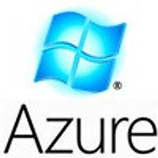



PaaS Examples

Slide 32
Software as a Service (SaaS)
The capability provided to the consumer is to use the provider’s applications running on a cloud infrastructure.
The applications are accessible from various client devices through a thin client interface such as a web browser (e.g., web-based email).
The consumer does not manage or control the underlying cloud infrastructure including network, servers, operating systems, storage, or even individual application capabilities, with the possible exception of limited user specific application configuration settings.

Slide 33
Software as a Service (SaaS)
SaaS model allows to use software applications as a service to end users.
SaaS is a software delivery methodology that provides licensed multi-tenant access to software and its functions remotely as a Web-based service.
•
•
•
Usually billed based on usage Usually multi tenant environment Highly scalable architecture

Slide 34


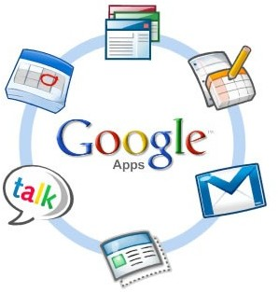

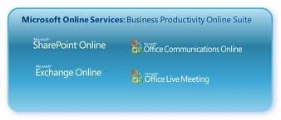

SaaS Examples

Slide 35











Cloud Services
Web 2.0 Interfaces
Software as a Service
End user applications
Scientific applications
Office automation, Photo editing,
CRM, and Social Networking
Examples: Google Documents, Facebook, Flickr, Salesforce
Platform as a Service
Runtime Environment for Applications
Development and Data Processing Platforms
Examples: Windows Azure, Hadoop, Google AppEngine, Aneka
Infrastructure as a Service
Virtualized Servers
Storage and Networking
Examples: Amazon EC2, S3, Rightscale, vCloud

Slide 36
Desktop as a Service (DaaS)
Desktop-as-a-Service (DaaS) is a form of virtual desktop infrastructure (VDI) in which the VDI is outsourced and handled by a third party. Also called hosted desktop services, desktop-as-a-service is frequently delivered as a cloud service along with the apps needed for use on the virtual desktop.
Desktop-as-a-Service provider typically handles storing, securing and backing up a user's data, as well as upgrades for the DaaS service and supported applications.

Slide 37
Some of the more well-known Desktop-as-a-Service providers include:
VMware Horizon DaaS (formerly Desktone. ... )
AWS Workspaces
Citrix
Microsoft Azure RemoteApp (still in Tech Preview as of this writing)
Virtual Bridges VERDE (relatively new to the platform space)
dinCloud
tuCloud
.

Slide 38
Network as a Service (NaaS)
Networking as a Service (NaaS) is the sale of network services from third parties to customers that don’t want to build their own networking infrastructure.
NaaS packages networking resources, services, and applications as a product that can be purchased for a number of users, usually for a contracted period of time. It can include services such as Wide Area Networking (WAN) connectivity, data-center connectivity, bandwidth on demand (BoD), security services, and other applications.

Slide 39
Many forms of NaaS:
Virtualization technology provides the platform for NaaS, which is related to other cloud services.
Services are offered by Cloud Service Providers (CSP) in addition to NaaS include Software as a Service (SaaS), a computing platform for developing or hosting applications, known as Platform as a Service (PaaS); or an entire networking or computing infrastructure, known as Infrastructure as a Service (IaaS).
Cloud services such as NaaS and Paas are provided by building a large, scalable infrastructure that can be virtualized so that it can be sold to individual customers.

Slide 40
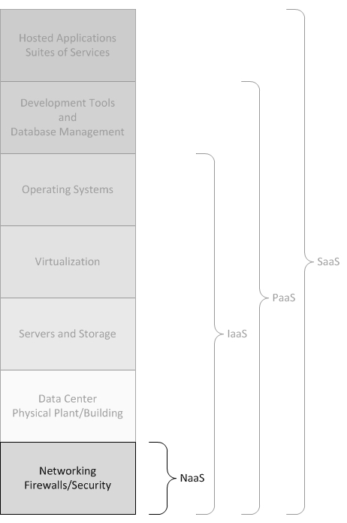

Slide 41
NaaS can include flexible and extended Virtual Private Network (VPN), bandwidth on demand, custom routing, multicast protocols, security firewall, intrusions detection and prevention, Wide Area Network (WAN), content monitoring and filtering, and antivirus.
NaaS Variation
Some implementations of Network as a Service (NaaS) are referred to as Telco as a Service (TaaS).

Slide 42
Anything as a Service (XaaS)
Anything-as-a-service, or XaaS, refers to the growing diversity of services available over the Internet via cloud computing as opposed to being provided locally, or on premises. Also known as everything-as-a-service, anything-as-a-service reflects the vast potential for on-demand cloud services and is already being heavily marketed and promoted by companies like VMware and HP.

Slide 43
Anything as a Service (XaaS)
Anything-as-a-service derives the "X" in its XaaS acronym as a result of being a catch-all term for everything from software-as-a-service (SaaS) to storage-as-a-service, desktop-as-a-service (DaaS), disaster recovery-as-a-service (DRaaS), network-as-a-service (NaaS), infrastructure-as-a-service (IaaS) and platform-as-a-service (PaaS), and even emerging services such as marketing-as-a-service and healthcare-as-a-service.

Slide 44
Utility Computing
Utility computing is the process of providing computing service through an on-demand, pay-per-use billing method. Utility computing is a computing business model in which the provider owns, operates and manages the computing infrastructure and resources, and the subscribers accesses it as and when required on a rental or metered basis.
Utility computing solutions can include virtual servers, virtual storage, virtual software, backup and most IT solutions.
Cloud computing, grid computing and managed IT services are based on the concept of utility computing.

Slide 45
Utility Computing Example:
A startup develops their services on a cloud computing platform. Initially they only use a few computers. They are charged by the hour for computing instances and based on metered usage of data storage and bandwidth.
As the popularity of the service grows, they automatically scale by requesting more instances using an API. The cloud platform offers volume discounts whereby prices fall as you use more. This allows the startup to scale with declining operating costs related to computing.

Slide 46
Elastic Computing
Elastic computing is a concept in cloud computing in which computing resources can be scaled up and down easily by the cloud service provider.
Elastic computing is the ability of a cloud service provider to provision flexible computing power when and wherever required. The elasticity of these resources can be in terms of processing power, storage, bandwidth, etc.
Elastic Computing gives HPC (High Performance Computing) administrators the ability to manage resource expansion and contraction to increase productivity by providing additional resources when required.

Slide 47

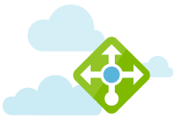

Related products and services:
Azure SQL Database
Managed relational SQL Database as a service
Load Balancer
Deliver high availability and network performance to your applications
Traffic Manager
Route incoming traffic for high performance and availability

Slide 48
View this demonstration of Elastic Computing by Nick Ihli:
http://www.adaptivecomputing.com/demos/elastic-computing/
http://www.adaptivecomputing.com/products/hpc-products/elastic-computing/

Slide 49
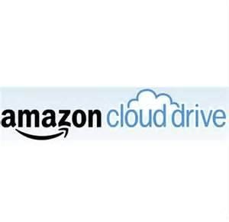
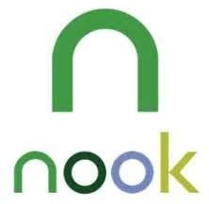


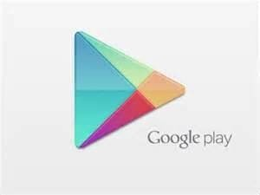

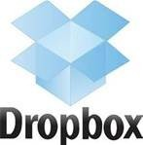









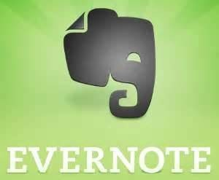

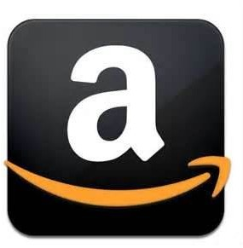
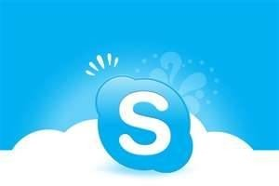

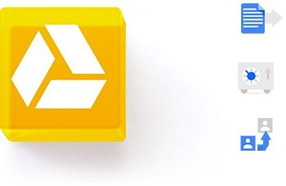
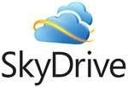

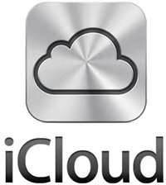
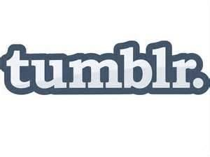



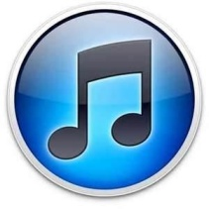

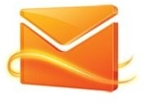


Do you Use the Cloud?

Slide 50
Advantages
•
•
•
•
•
•
•
•
•
•
•
Lower computer costs Improved performance:
Reduced software costs Instant software updates
Improved document format compatibility Unlimited storage capacity
Increased data reliability Universal document access Latest version availability Easier group collaboration Device independence

Slide 51
Disadvantages
•
•
•
•
•
•
Requires a constant Internet connection
Does not work well with low-speed connections Features might be limited
Can be slow
Stored data can be lost
Stored data might not be secure

Slide 52

Cloud Storage
•
Create an Account User name and password.
•
Content lives with the account in the cloud.
•
Log onto any computer with Wi-Fi to find your content

Slide 53

Download For Storage
•
•
•
•
•
Download a cloud based app to on your computer
The app lives on your Computer Save files to the app
When connected to the Internet it will sync with the cloud The Cloud can be accessed from any Internet connection

Slide 54
Thank
you…
Question…?

